Slide 1

TEXT TO IMAGE GENERATOR
Zeroth Review
Date: 09th April 2021
Project Team Members :
Ms. D. HARIKA : 17WH1A0570
Ms. G. JAHNAVI PRIYA : 17WH1A0573
Ms. S. SAII SWETA : 17WH1A05B0
Internal Guide: Prof. R.S.MURALI NATH
Designation: Professor I/C Accreditations
Department of Computer Science & Engineering
BVRIT HYDERABAD College of Engineering for Women

Slide 2
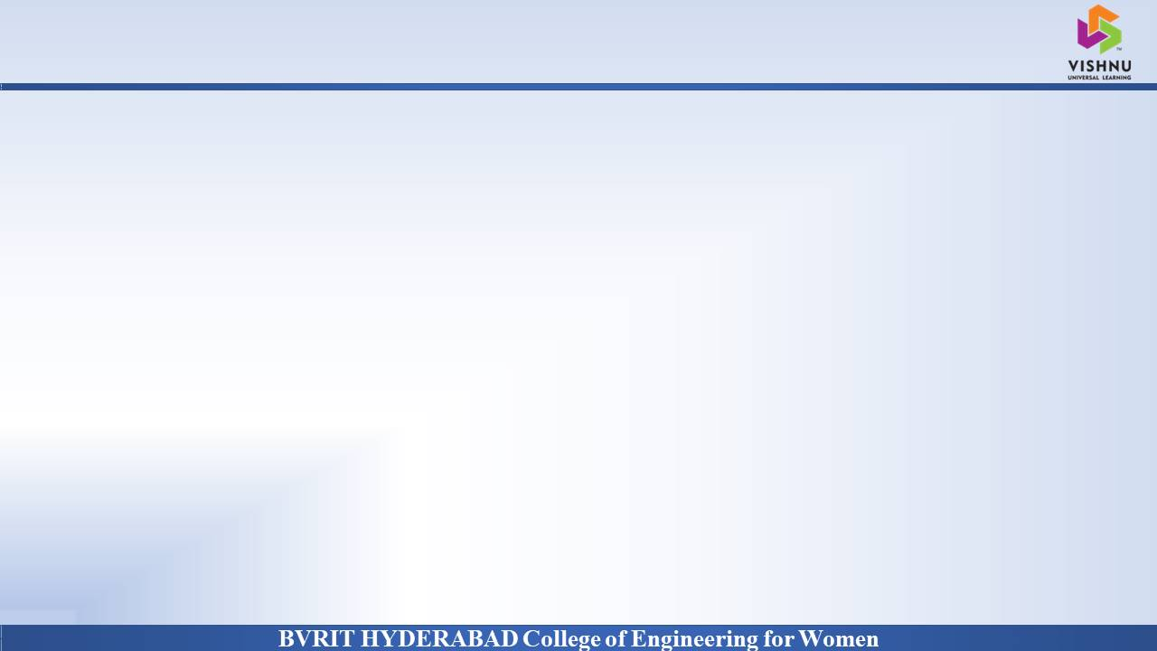
PROJECT INTRODUCTION
Why Should I Study this course?
DOMAIN
AI/ML
PROJECT TYPE
Existing System
Translating information between text and image is a fundamental problem in artificial intelligence, connecting natural language processing and computer vision. In the past few years, research on text-to-image generation begun to generate plausible images using datasets of specific categories like birds and flowers.
Proposed System
Synthesizing objects with a complex shape, however, is still challenging. For example, animals and humans have many degrees of freedom, there by increasing the complexity of these images. Our project Text – to - Image Generator deals with the images of these complex shapes using Generative Adversarial Networks (GAN).
Examples
BVRIT HYDERABAD College of Engineering for Women

Slide 3
SYSTEM SPECIFICATIONS
Why Should I Study this course?
ENVIRONMENT | SPECIFICATIONS
HARDWARE | Processor - Intel Core i7 Memory(RAM) - 8 GB Storage – 1 TB
SOFTWARE | Python (TensorFlow & NumPy) OS - Windows 10 Google Colab
DATA SETS | Caltech-UCSD Birds 200
Examples
BVRIT HYDERABAD College of Engineering for Women

Slide 4
PROJECT PLAN
Why Should I Study this course?
SNO | REVIEW | DATES | TOPICS
1 | Zeroth-Review | 09-04-2021 | Software Requirements Specification Data set Base paper and references
2 | I-Review | < > | Zeroth Review slides Abstract Architecture diagram Data Model Partial implementation of proposed system
3 | II-Review | < > | Complete implementation Results & Discussions Project Report Draft
Examples
BVRIT HYDERABAD College of Engineering for Women

Slide 5
REFERENCES
Why Should I Study this course?
Papers :
“StackGAN: Text to Photo-realistic Image Synthesis with Stacked Generative Adversarial Networks”, Han Zhang, Tao Xu, Hongsheng Li, Shaoting Zhang, Xiaogang Wang, Xiaolei Huang, Dimitris Metaxas, date of publication August 5, 2017
“TiVGAN: Text to Image to Video Generation With Step-by-Step Evolutionary Generator”, IEEE Access, DOYEON KIM, DONGGYU JOO and JUNMO KIM School of Electrical Engineering, Korea Advanced Institute of Science and Technology, Daejeon 34141, South Korea Corresponding author: Junmo Kim, date of publication August 19, 2020.
“A Realistic Image Generation of Face From Text Description Using the Fully Trained Generative Adversarial Networks”, MUHAMMAD ZEESHAN KHAN, SAIRA JABEEN, MUHAMMAD USMAN GHANI KHAN, TANZILA SABA, ASIM REHMAT, AMJAD REHMAN and USMAN TARIQ, date of publication August 10, 2020.
Article :
https://towardsdatascience.com/text-to-image-a3b201b003ae
Examples
BVRIT HYDERABAD College of Engineering for Women

Slide 6
Thankyou
BVRIT HYDERABAD College of Engineering for Women

